Slide 1
Election Forecasting & Pollster Bias
Haley Reed

Slide 2
Goals
Election Forecasting Model
1
Pollster Bias
2
Bayesian Hierarchical Modeling
3
Functionality of daily updates
Special consideration to pollster bias, how to weight pollster, and predict bias.
Use JAGS, R, RStudio to do so

Slide 3
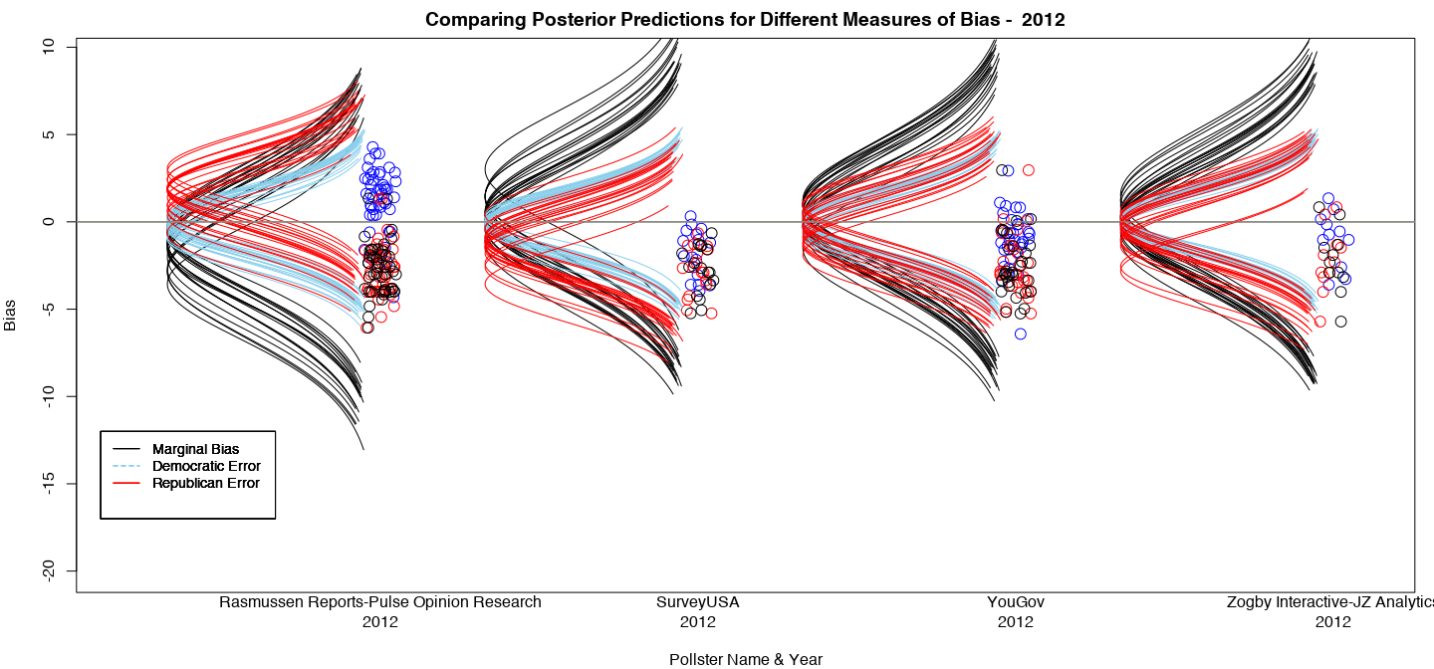
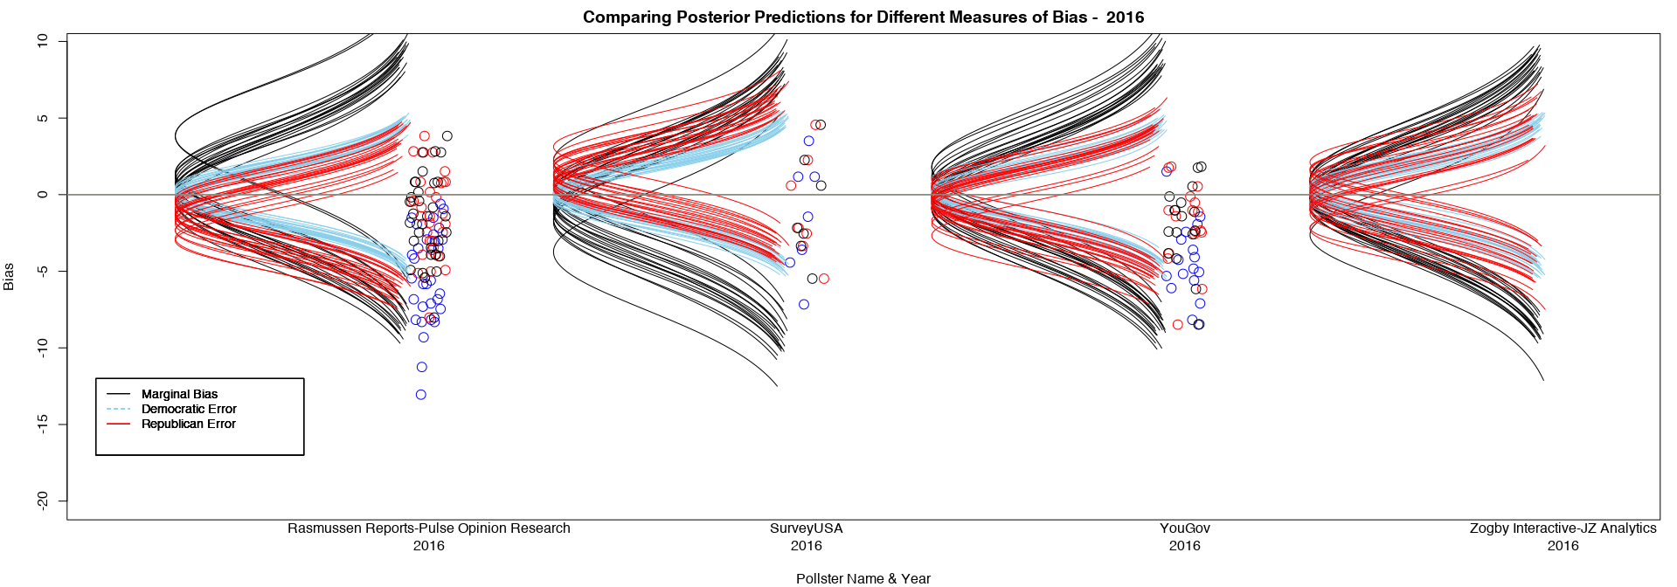
Notes:
Right now I’m looking at pollster biases categorized by year and pollster. But comparing marginal bias, republican error, and democratic error and the relationships between those 3.

Slide 4
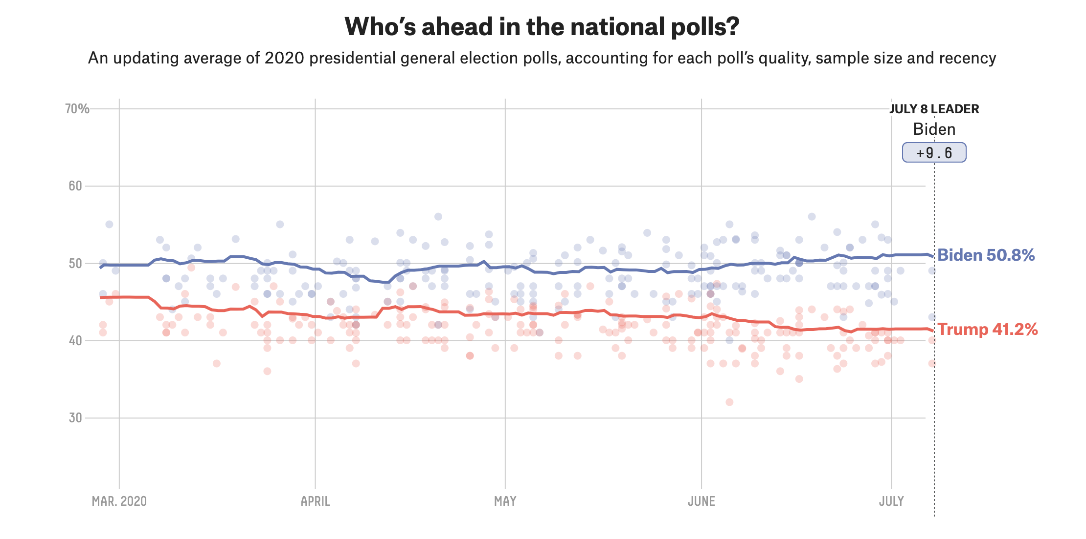
Background
Closeness of recent elections
Proprietary Algorithms
Proliferation of forecasting

Slide 5
How can we do Forecasting?
Polls measure public opinion
Representative?
Notes:
Polls and surveys are meant to measure how people think and feel about something rather than what they know about it. Polls seek to be reprehensive
Mode, and other things , effective representativeness

Slide 6




What is Bias?
Actual Republican Vote Share
Polled Republican Vote Share
Polled Democratic Vote Share
Actual Democratic Vote Share
Margin of Bias = -
Democratic Error
Republican Error
50%

Slide 7
“All models are wrong, but some are useful.”
—George E. P. Box
Notes:
British Statistician

Slide 8
Bayesian Statistics
Prior Distribution
Posterior Distribution
Likelihood Distribution
Starting Point
Varying Levels of Confidence
Scientifically Valid
Compromise between Likelihood & Prior
Relative to relative number of observations
Considers New Data
Notes:
While almost everyone is familiar with traditional, frequentist, or Fisherian statistics… this project uses Bayesian statistics to model this type of election data.
Why?
It allows the explicit integration of previous knowledge with new empirical data.
Avoids misinterpretation of p-values. Provides more information.
It has 3 parts:
Prior:
The prior distribution expresses current beliefs about the possibilities of certain events as a sort of “starting point” for further modeling
Valid priors are based on scientifically agreed upon empirical evidedence...
If you don’t have such empirics... low level of confidence in these prior beliefs can be mathematically transferred to the calculations so that the prediction has a minimal effect on the final conclusions made with Bayesian testing.
Known as non committal or vague prior
On the other hand, strong beliefs can be communicated so that new evidence has proportionally less impact on the final results of our statistical analysis, creating models that are more “stubborn”.
Likelihood:
The likelihood function answers the question, “What would be the chance of the observed results occurring if the unknown parameters had these specific values?”
In a poll it might be, “What is the chance of 487 out of 1,000 polled people supporting Trump if really 50% of the full population support him?”
Posterior Distribution:
The posterior distribution can be thought of as a compromise between the prior and likelihood functions. Which one has a larger impact can be determined by the relative number of observed observations, or implied past observations in the case of the prior, to each other.

Slide 9

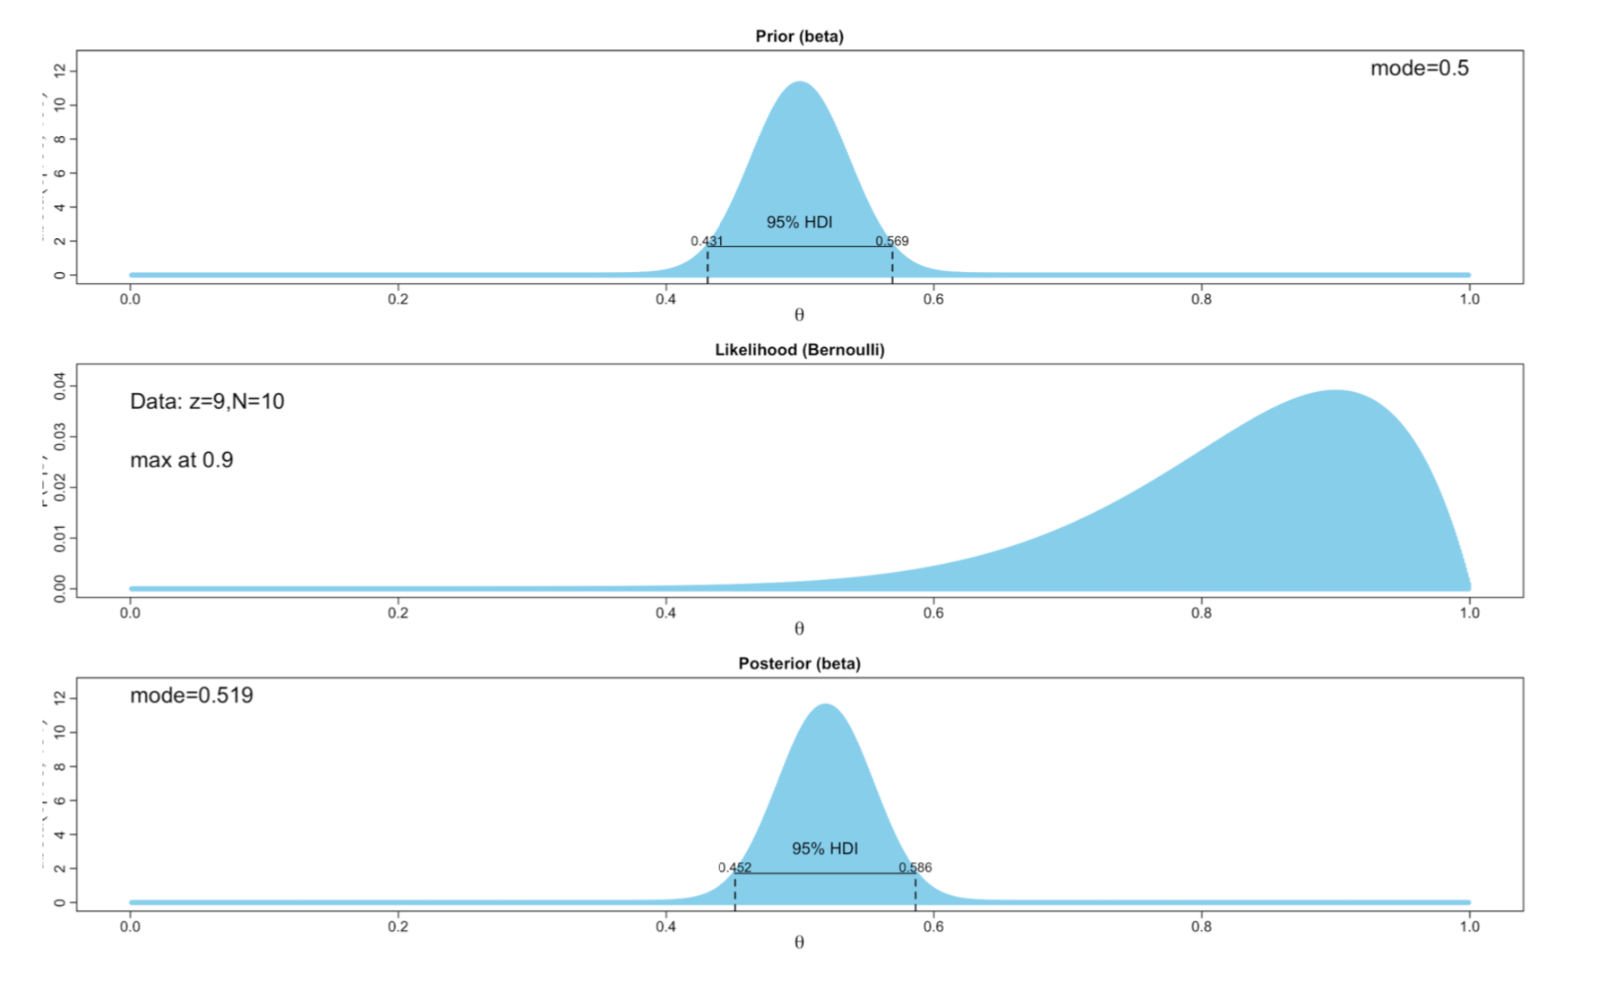
A picture is worth a thousand words
Notes:
This concept is much easier to explain with an example:
Suppose you had a government minted coin and high level of confidence that it is therefore fair and in the 10 flips observed, 9 came up heads, the likelihood function would have less of an impact on the posterior distribution than the prior distribution.
With Bayesian statistics, you would, reasonably, assume this was just a fluke rather than a biased coin.

Slide 10
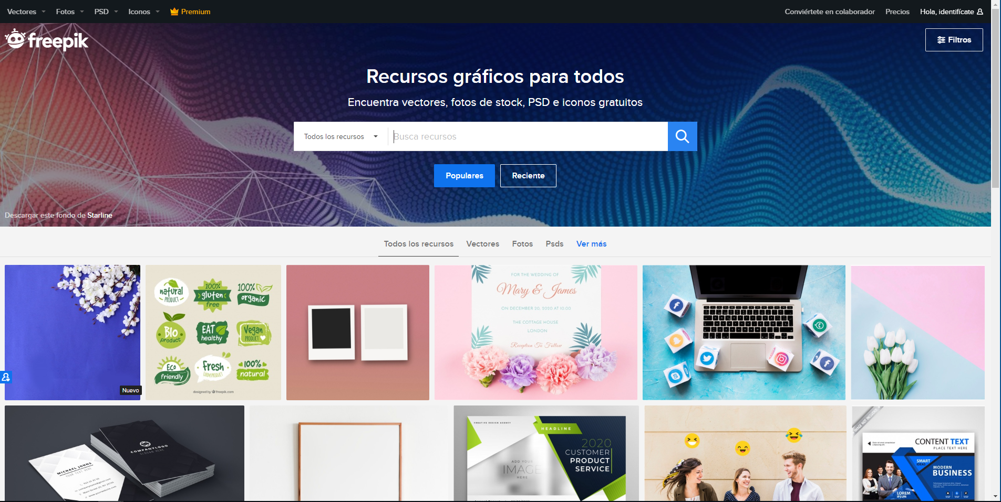
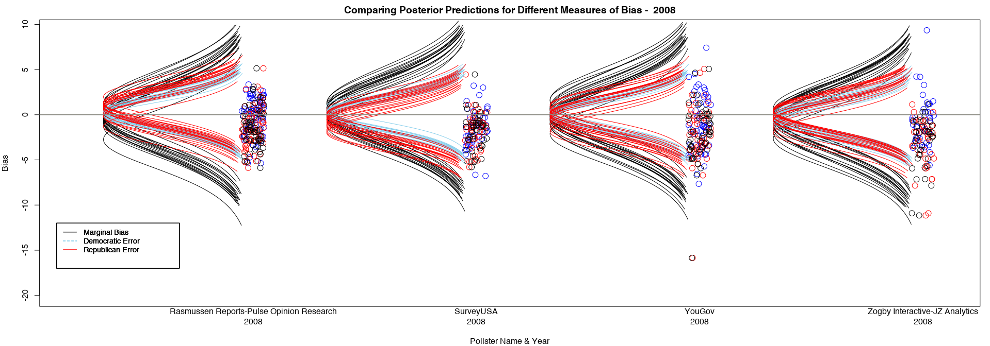

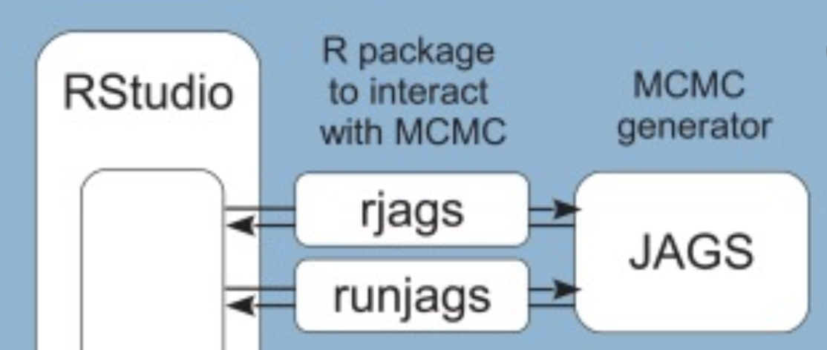
Implementation
R & RStudio
JAGS
To approximate posterior distrubtion
R
Notes:
Bayesian statistic predates Frequentist methods, only become possible because of the modernization and accessibility of computers and their simulation ability.
With that, This project has relied heavily upon R, RStudio, and JAGS (Just Another Gibbs Sampler) to model and process data.
JAGS processed data by using Markov Chain Monte Carlo Samping
MCMC methods are used to approximate the posterior distribution of a parameter of interest by random sampling in a probabilistic space.

Slide 11
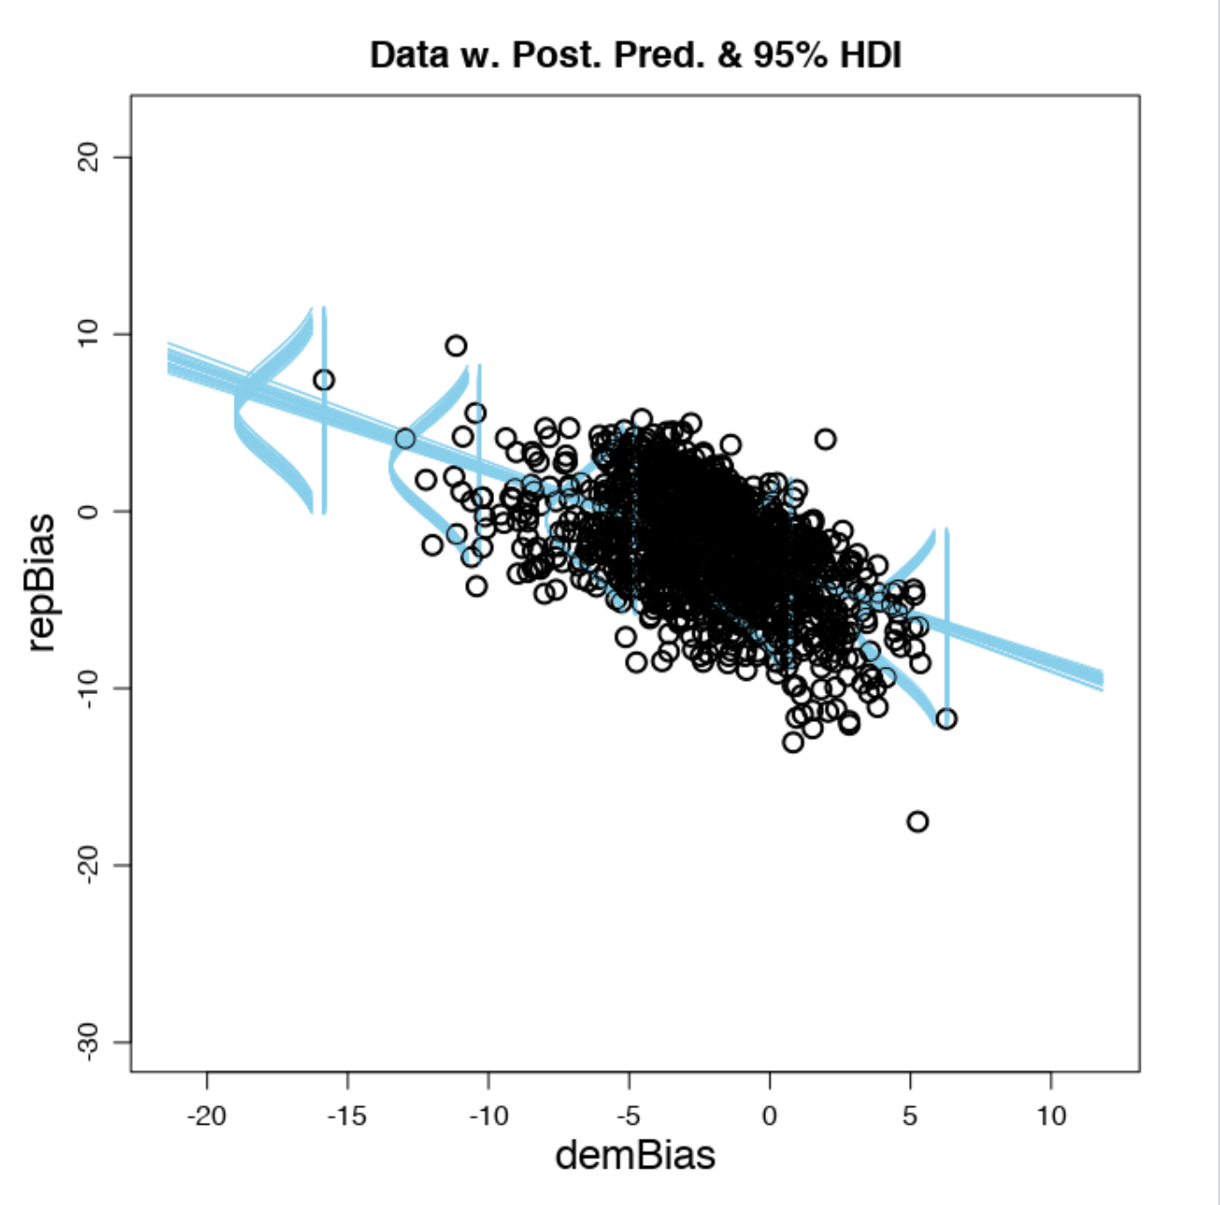
Results
Republican Bias
Democratic Bias
Notes:
Returning To our Original Graphic:
Bias varies by pollster
Bias varies by year
(Not shown in this graphic) there is a relationship between the number of undecided voters in a poll and the bias, especially bias measured in terms of Republican year

Slide 13
Up Next:
Create a weighted model
Time
Mode
Likely Voter/Registered Voter
Transparency
Sample Size
Notes:
Mode – is delivery mode- online, phone, mixed
Transparency dummy variable
Weighted Model will be used to determine how much weight each poll will be given , then the pollster bias adjustment would be applied
Then the sum of all weighted and corrected for bias of polls should produce a functioning model for if the election happened today

Slide 14
Acknowledgements

Slide 15
Citations
Notes:
-Marist Academy
-Kruscke Textbook
-538 – that visual of live forecast

